Slide 1
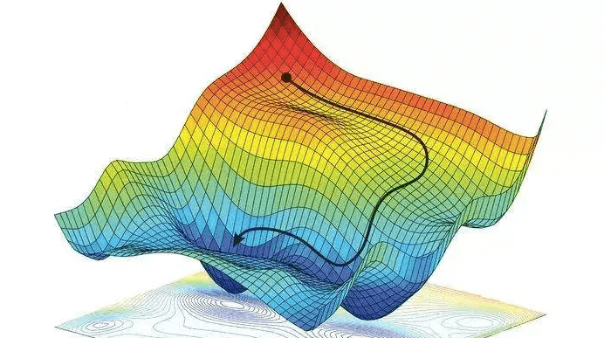
Policy Gradient Methods
Hongning Wang
CS@THU

Slide 2
Outline
Policy Gradient Theorem
REINFORCE: Monte Carlo Policy Gradient
Actor–Critic Methods

Slide 3
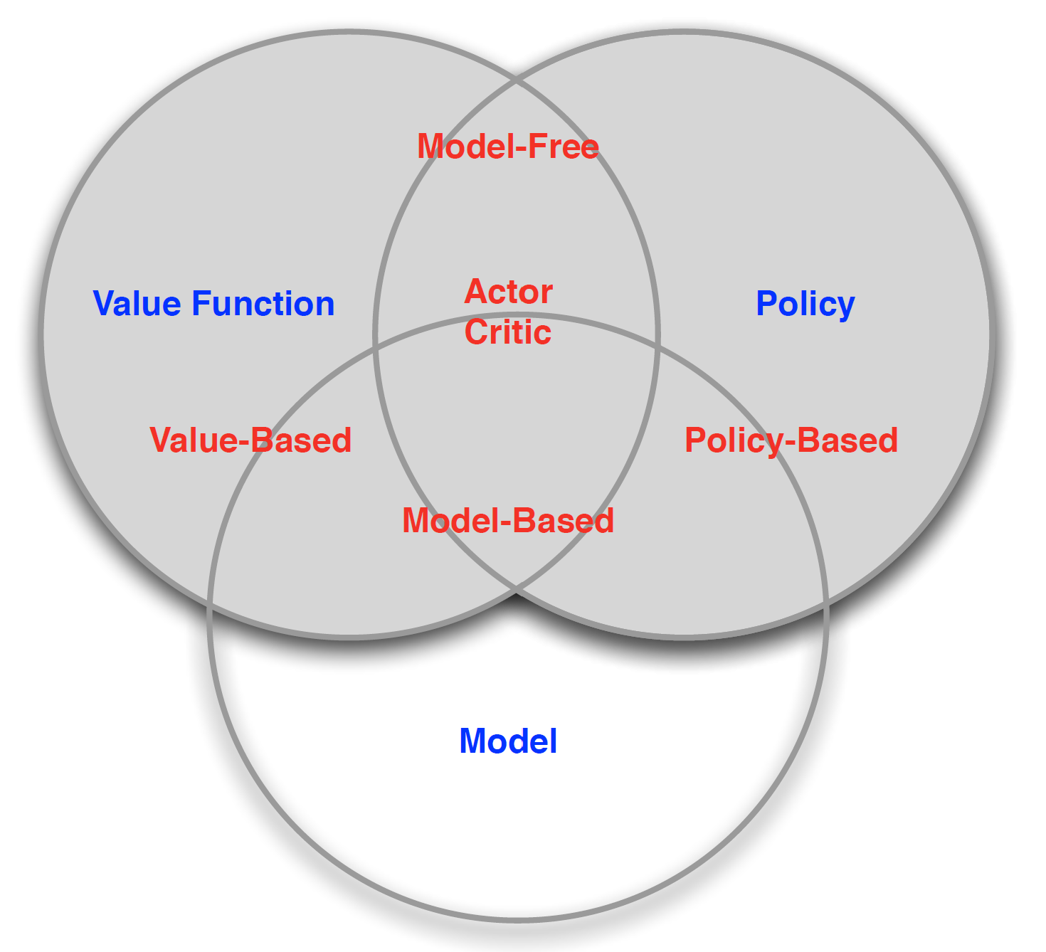
A taxonomy of RL solutions
Focus of today!
TD, MC
DP
Figure credit: David Silver, “Introduction to RL”

Slide 4
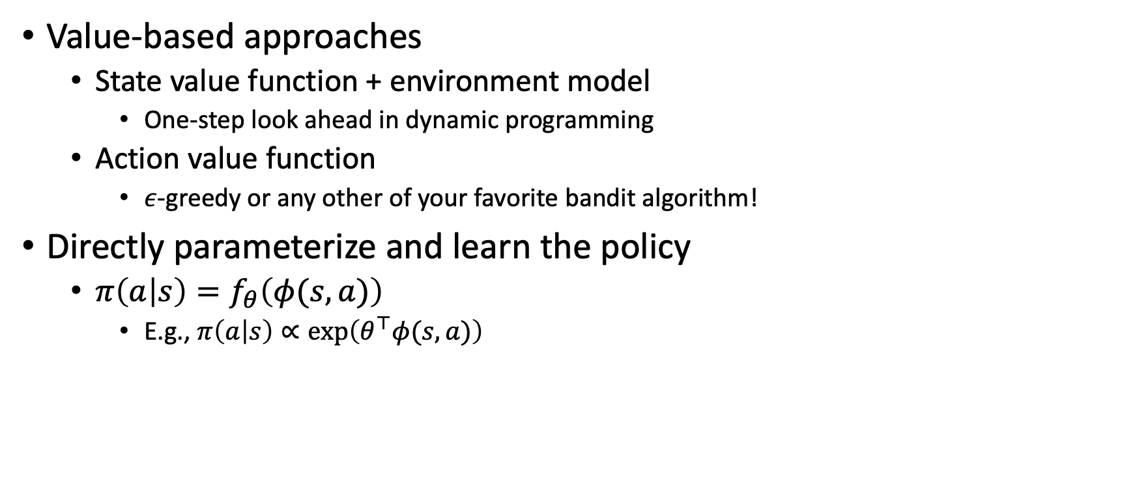
How to derive a policy
Value-based approaches
  State value function + environment model
    One-step look ahead in dynamic programming
  Action value function
    $ε$-greedy or any other of your favorite bandit algorithm!
Directly parameterize and learn the policy
  $π\left(a | s\right)=f_{θ}\left(φ(s,a)\right)$
    E.g., $π\left(a | s\right)∝\exp\left(θ^{⊤}φ(s,a)\right)$
Feature vector of state-action pair
Temperature of soft-max
No need to be related to the value function!
Why not directly define $π\left(a | s\right)∝exp⁡({λv\left(s,a\right)})$?

Slide 5
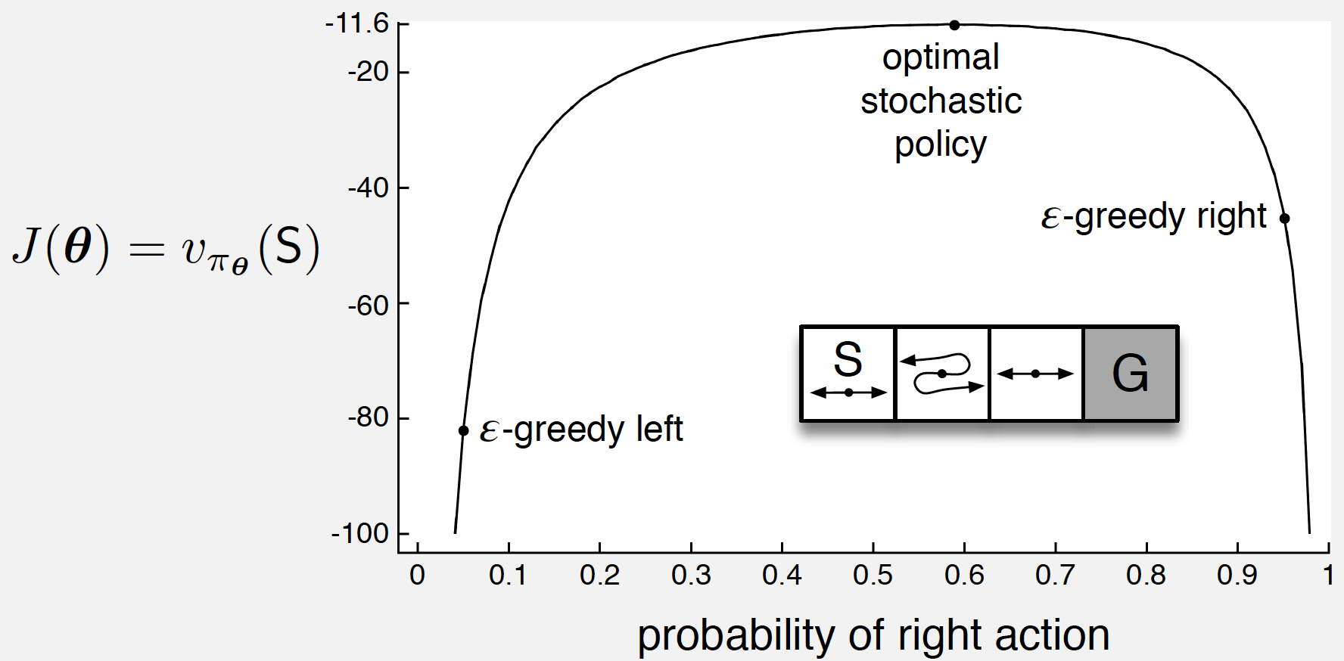


Advantage of direct policy learning in a toy example

Slide 6
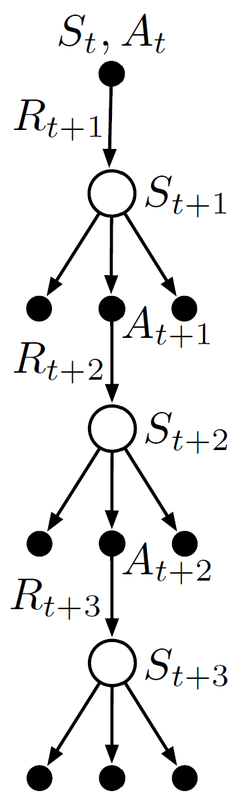
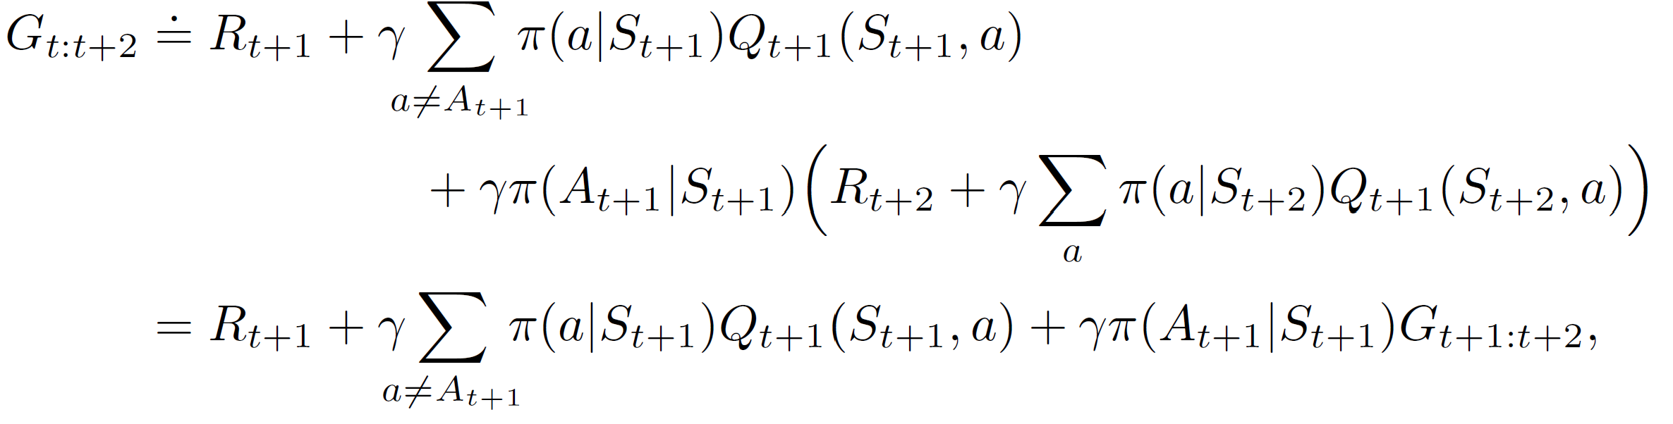

Recap: Tree Backup – an off-policy method
Without importance sampling
  One-step: Q-learning, expected Sarsa
We have sampled observations (e.g., from behavior policy)
Kind of expected Sarsa
We do not have any observations;
use current estimate instead!
by definition, recursion appears!
Why is it an off-policy method?

Slide 7
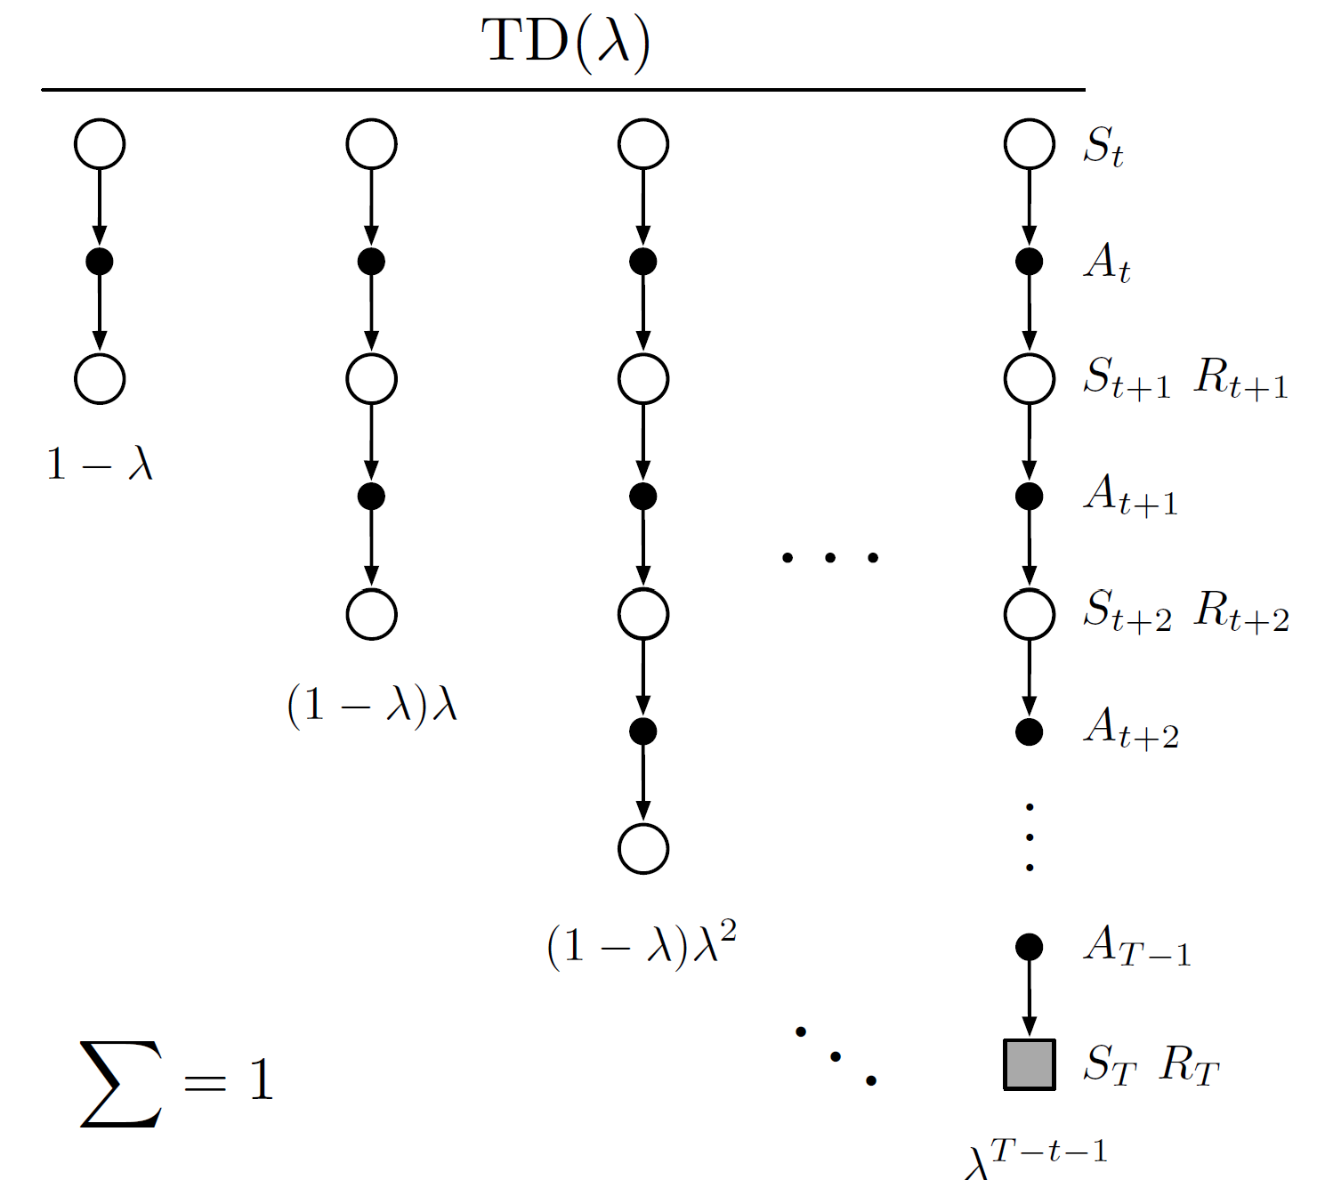
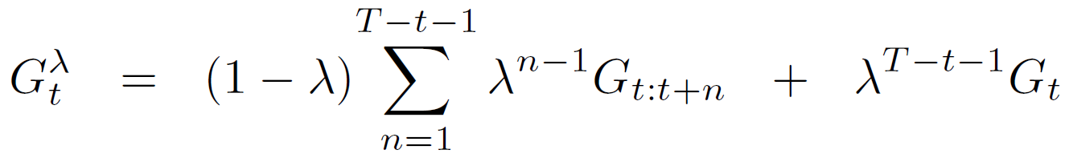
Recap: unifying n steps in TD methods
Do we have to wait until n steps for a valid update?
$λ$-return:
Soft version of n-step return, without explicit n
Weight the return so far

Slide 8

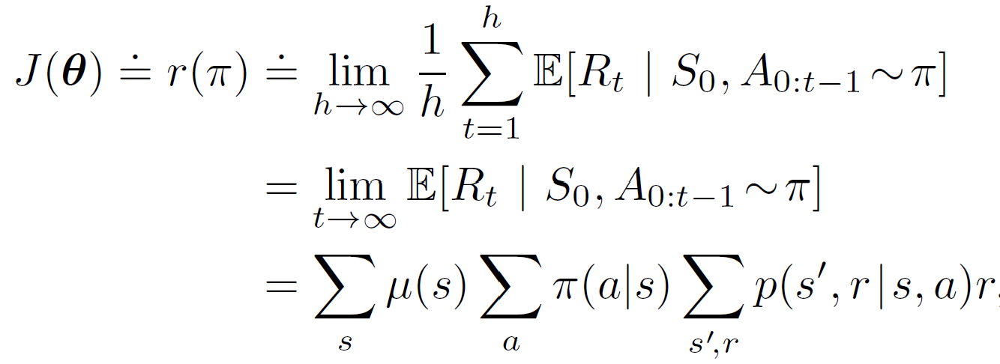

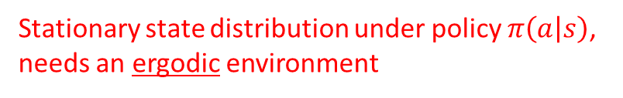
Policy learning as an optimization problem
Objective function $J(θ)$
  In an episodic environment
    Value of a particular initial state $J\left(θ\right)=v_{π_{θ}}\left(s_{0}\right)$
  In a continuous environment
    Average rate of reward per time step
Then how should we optimize it?
Gradient ascent!
Stationary state distribution under policy $π\left(a | s\right)$, needs an ergodic environment

Slide 9
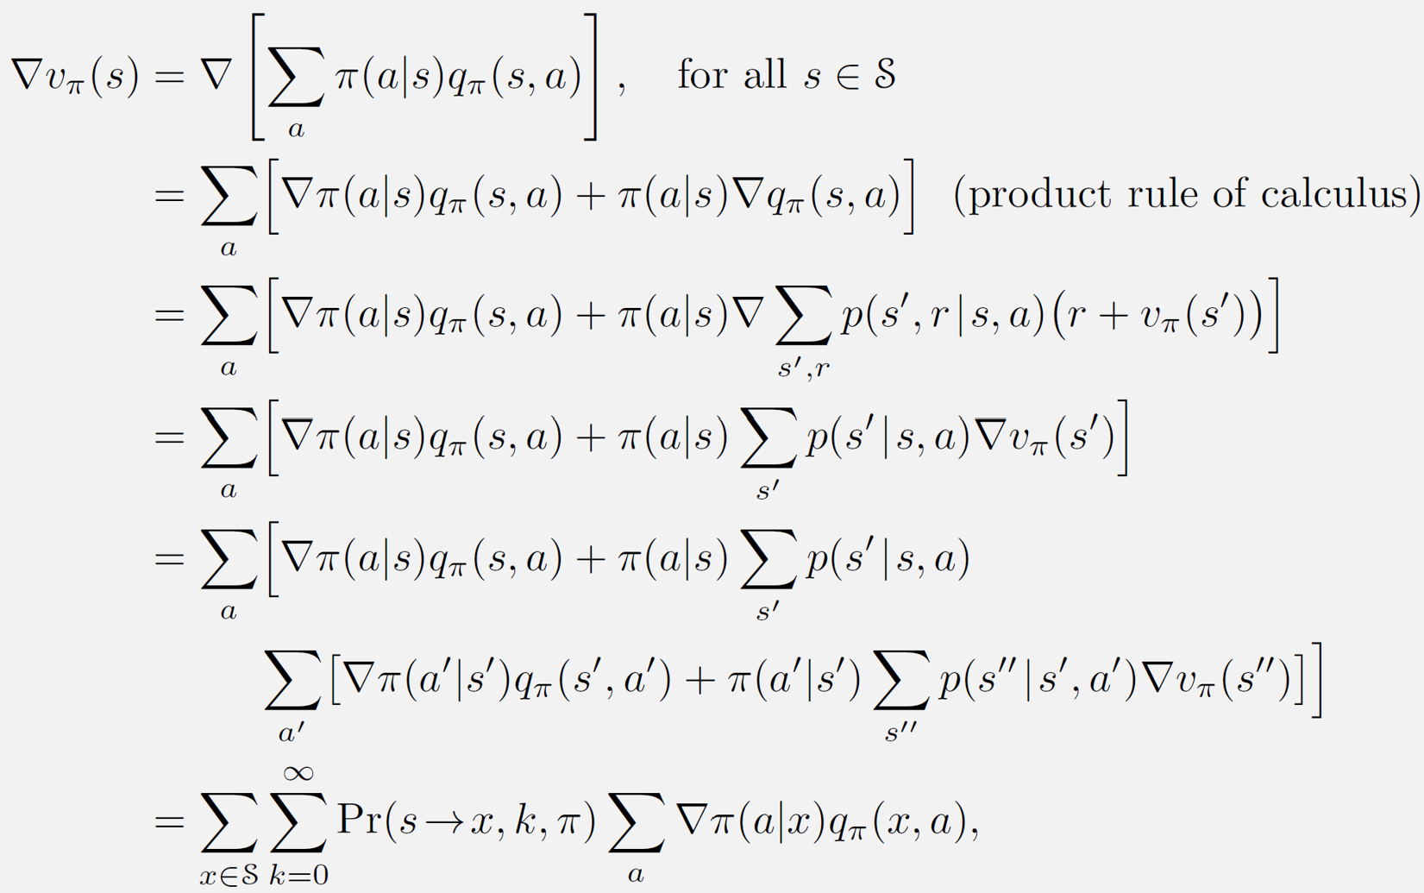
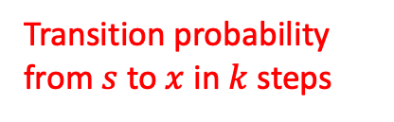
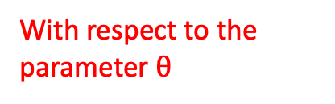
Policy gradient theorem
Episodic task as an example
With respect to the parameter $θ$
recursion!
Transition probability from $s$ to $x$ in $k$ steps

Slide 10
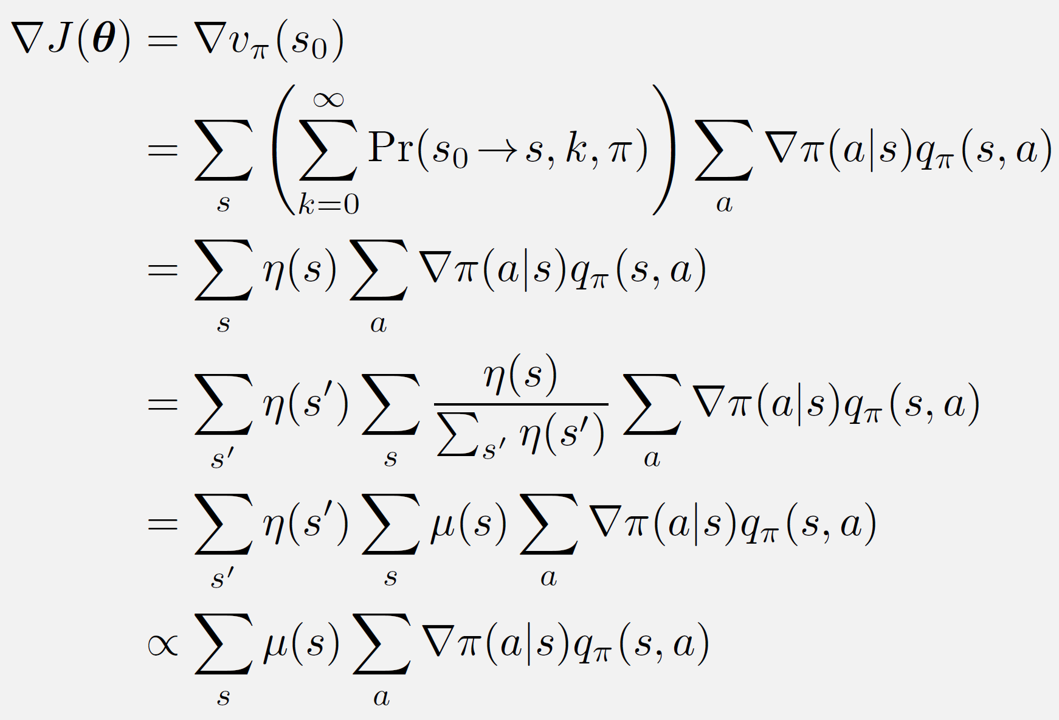
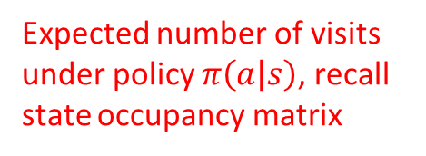
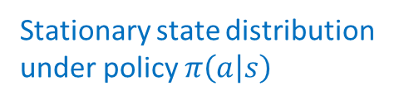
Policy gradient theorem (continued)
Expected number of visits under policy $π\left(a | s\right)$, recall state occupancy matrix
Stationary state distribution under policy $π\left(a | s\right)$
move the constant into the step size of gradient ascent
The return after taking this action
The reason we take this action

Slide 11
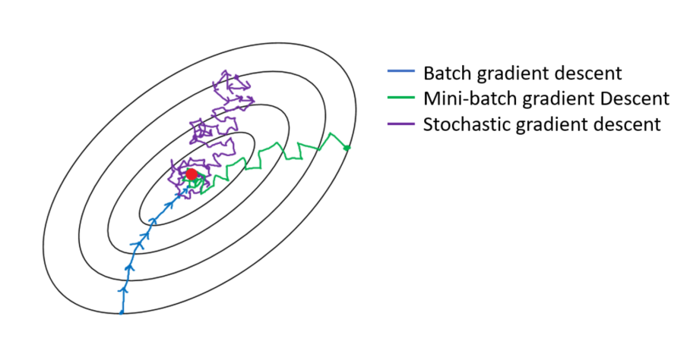
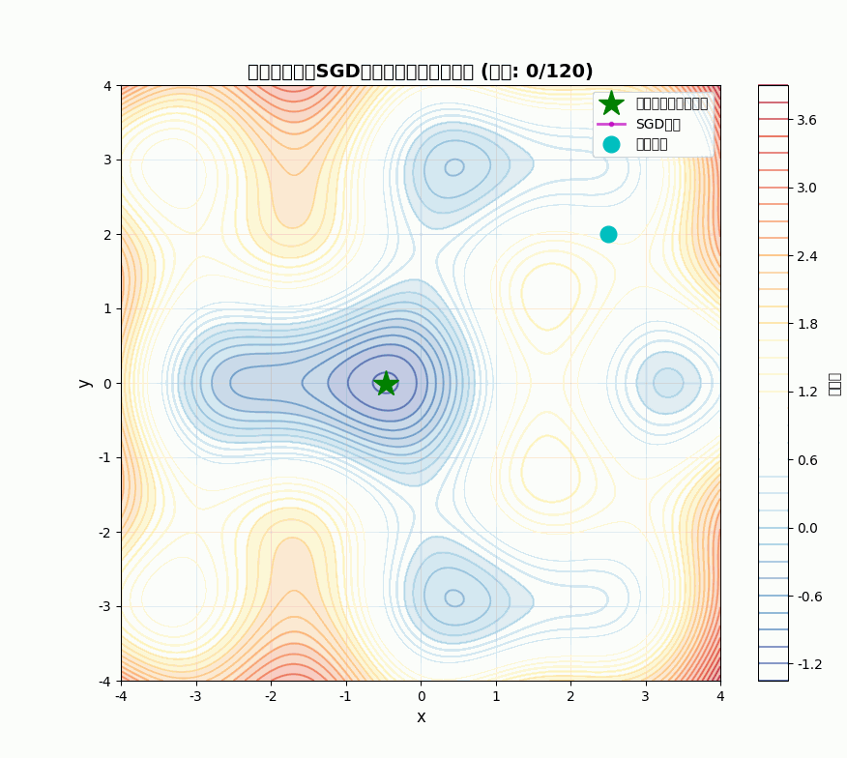

REINFORCE: Monte Carlo policy gradient
Stochastic gradient descent
  $θ←θ−η∇Q(x_{i},θ)$
Gradient at a sampled point

Slide 12
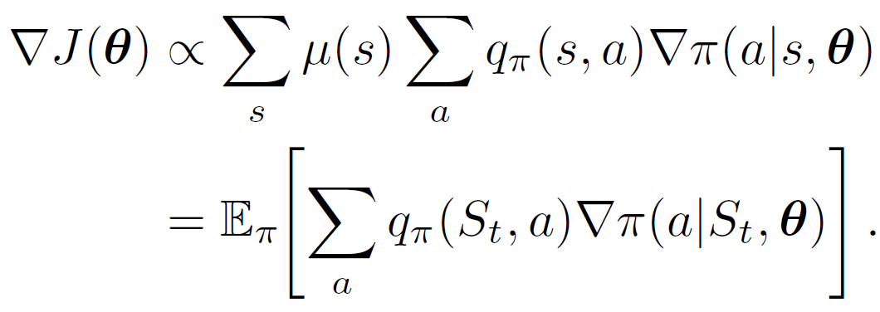

REINFORCE: Monte Carlo policy gradient
Sample gradients for policy optimization
The particular state visited
On policy
The is so-called “all action” method, looks familiar?
Target for Monte Carlo method

Slide 13
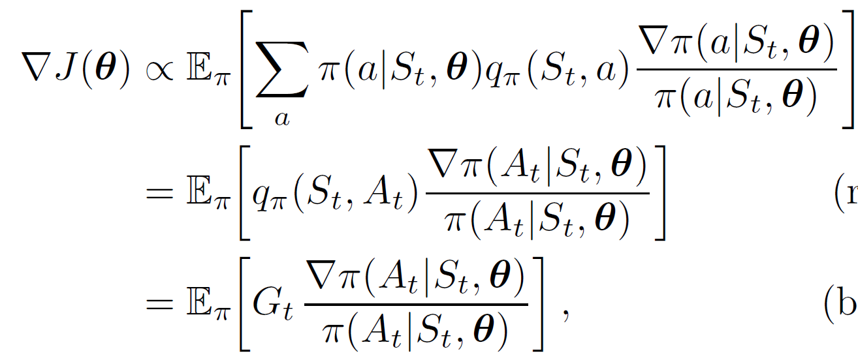



REINFORCE: Monte Carlo policy gradient
Sample gradients for policy optimization
The action taken by policy $π\left(a | s\right)$
Gradient: the direction and rate of fastest increase
Return under policy $π\left(a | s\right)$
Encourage the action that leads to a high return
Discount the action that is preferred by the current policy
Sample gradient for policy update
A sample of return, needs to wait for the episode
Completely from the environment, no need to know the MDP!

Slide 14
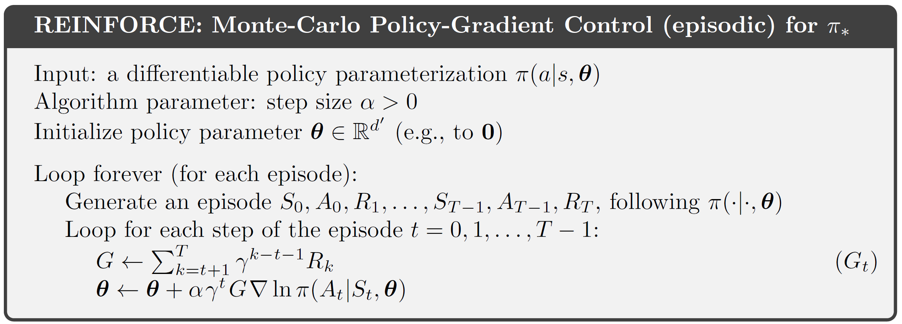
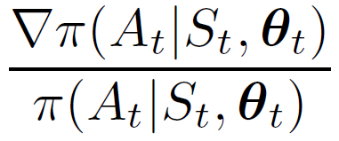


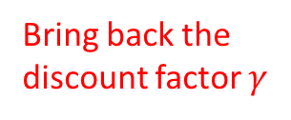
REINFORCE: Monte Carlo policy gradient
It has to be an on-policy method!
This is the updated policy!
Bring back the discount factor $γ$

Slide 15
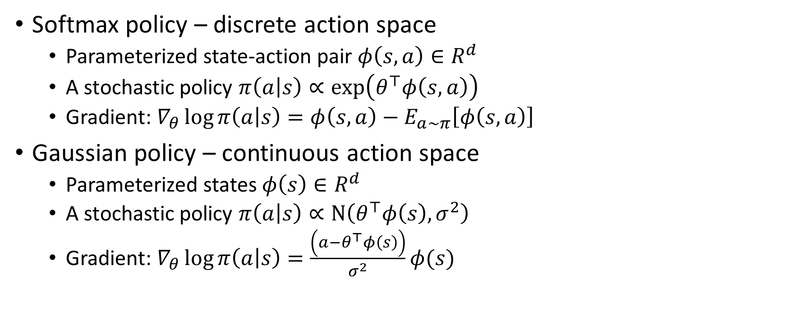
Construction of policy
Softmax policy – discrete action space
  Parameterized state-action pair $φ\left(s,a\right)∈R^{d}$
  A stochastic policy $π\left(a | s\right)∝\exp\left(θ^{⊤}φ\left(s,a\right)\right)$
  Gradient: $∇_{θ}\log{π\left(a | s\right)}=φ\left(s,a\right)−E_{a∼π}\left[φ\left(s,a\right)\right]$
Gaussian policy – continuous action space
  Parameterized states $φ\left(s\right)∈R^{d}$
  A stochastic policy $π\left(a | s\right)∝N\left(θ^{⊤}φ\left(s\right), σ^{2}\right)$
  Gradient: $∇_{θ}\log{π\left(a | s\right)}=\frac{\left(a−θ^{⊤}φ\left(s\right)\right)}{σ^{2}}φ(s)$
a feature vector
a distribution over actions
a feature vector about the state
a scalar action can be extended to vectorized actions

Slide 16
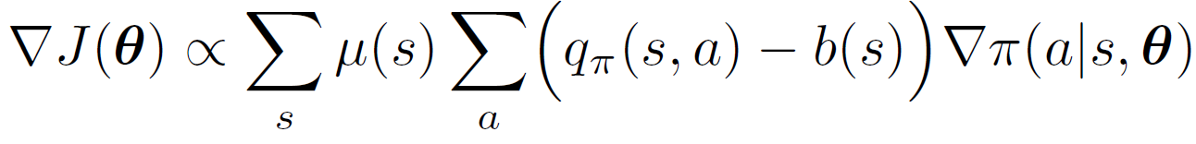
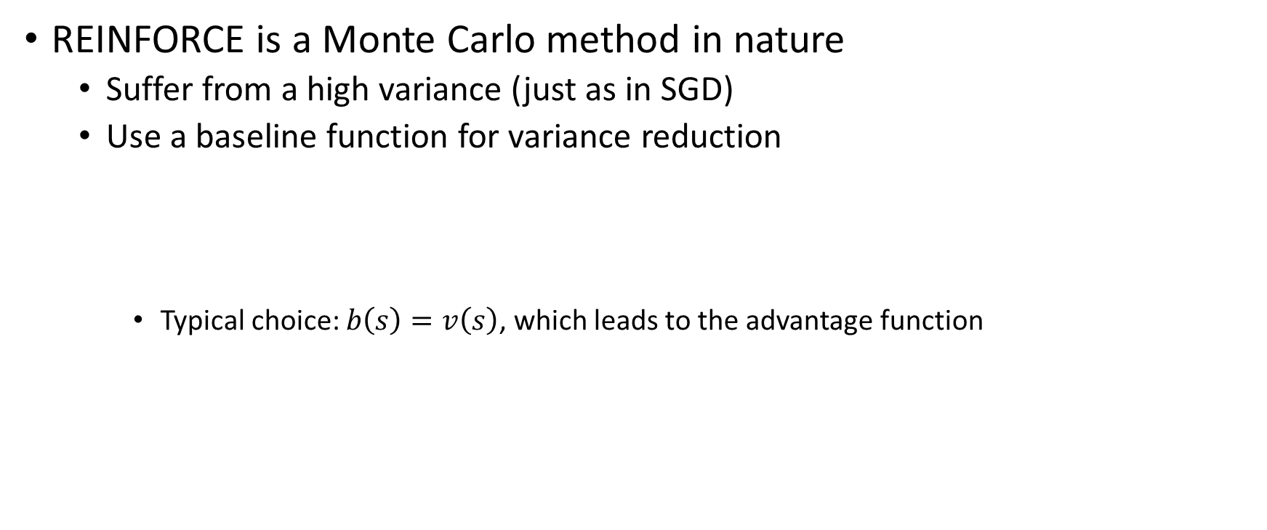


REINFORCE with baseline
REINFORCE is a Monte Carlo method in nature
  Suffer from a high variance (just as in SGD)
  Use a baseline function for variance reduction
    Typical choice: $b\left(s\right)=v\left(s\right)$, which leads to the advantage function
how?
Any function independent of action $a$
$A_{π}\left(s,a\right)=q_{π}\left(s,a\right)−v_{π}(s)$

Slide 17
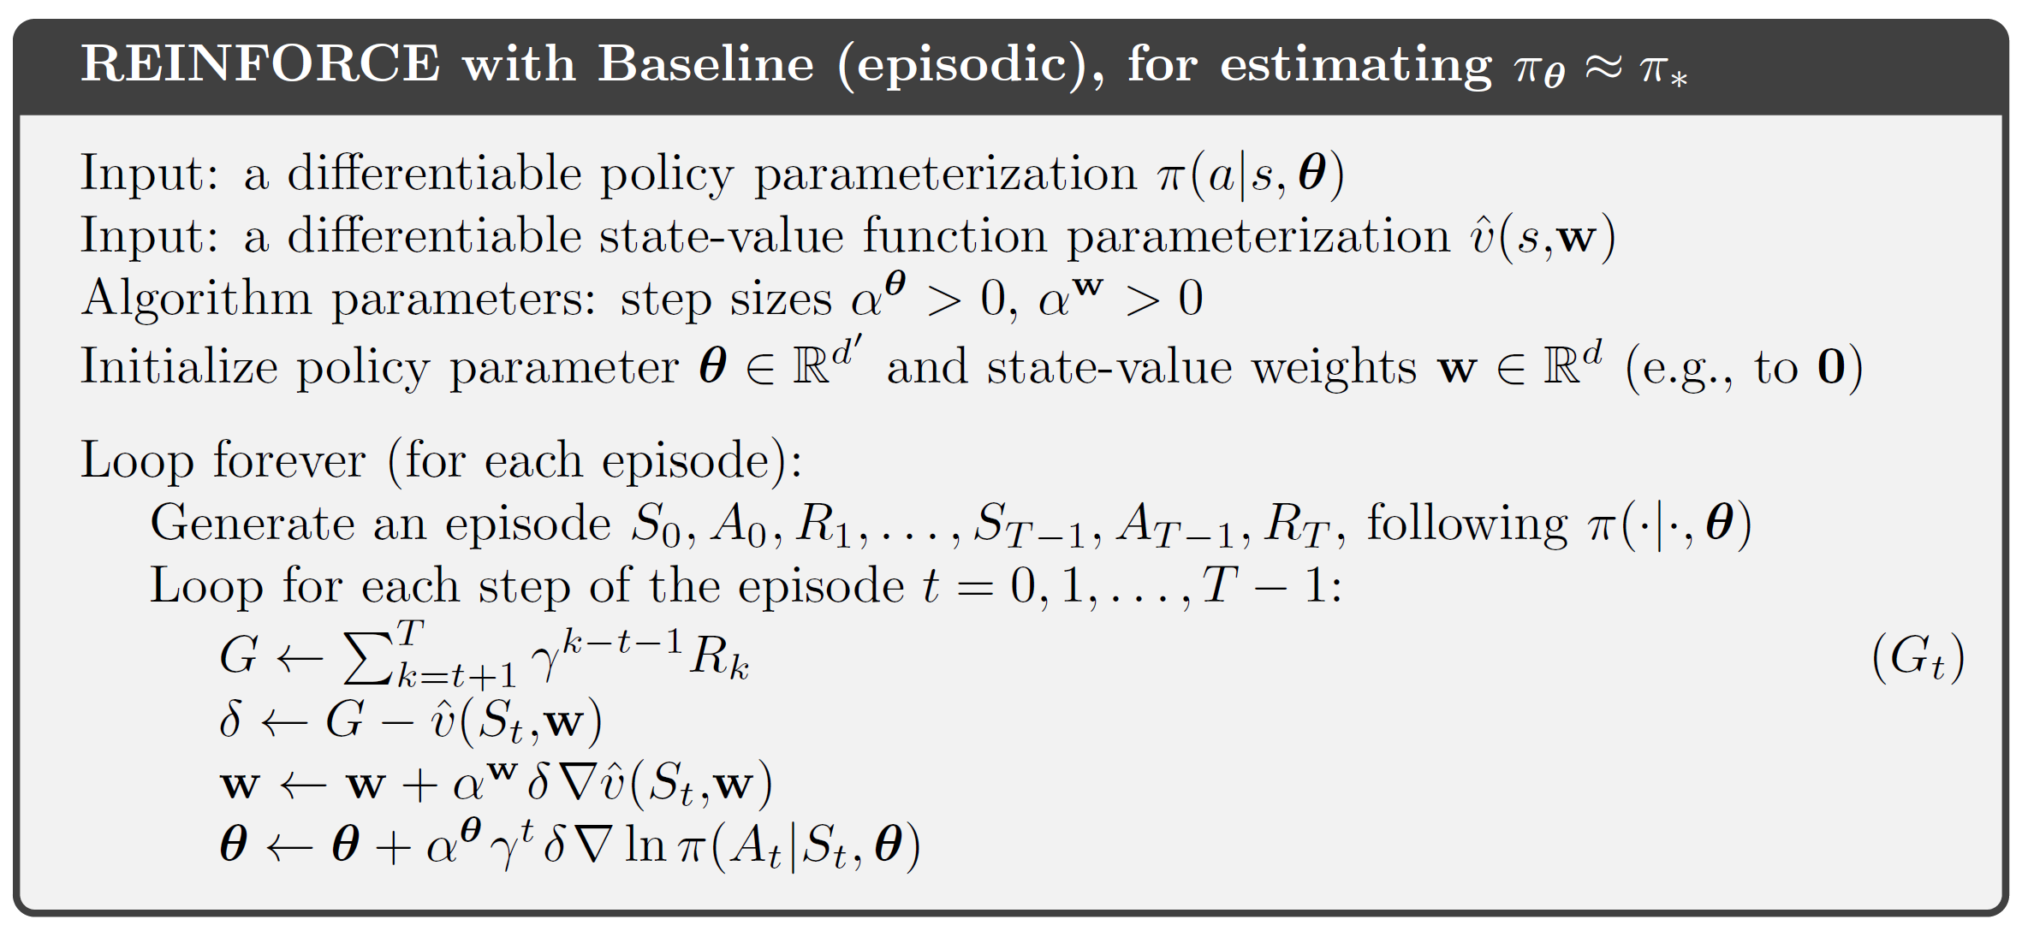
REINFORCE with advantage function
Approximated advantage function

Slide 18
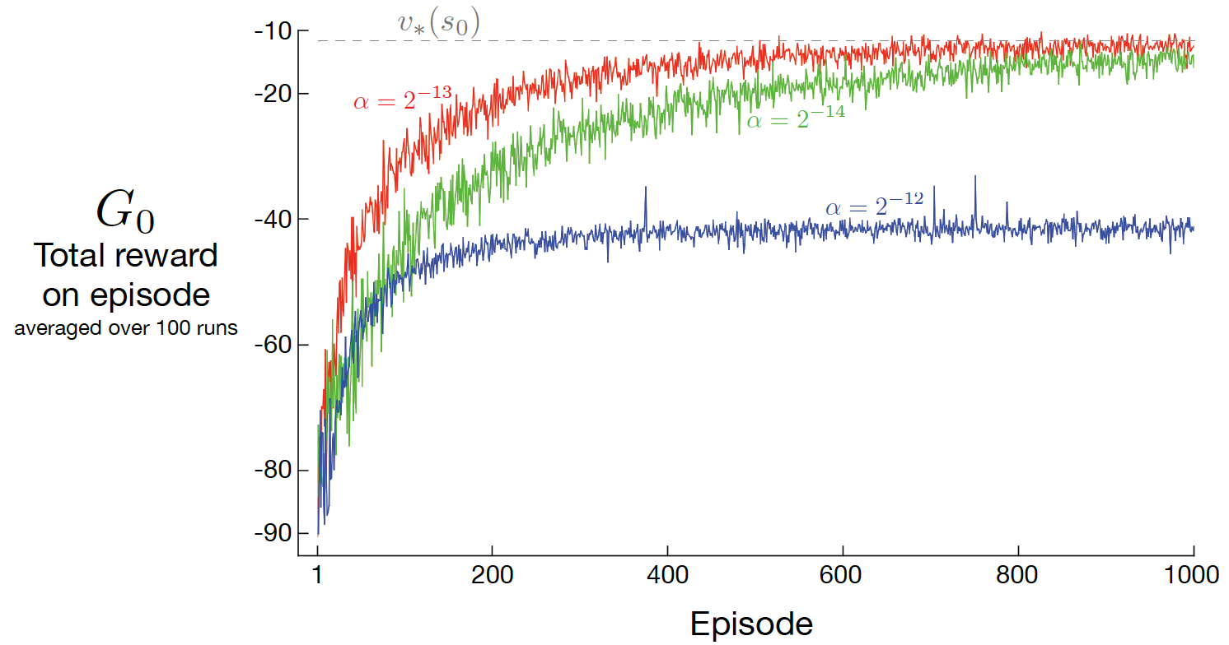
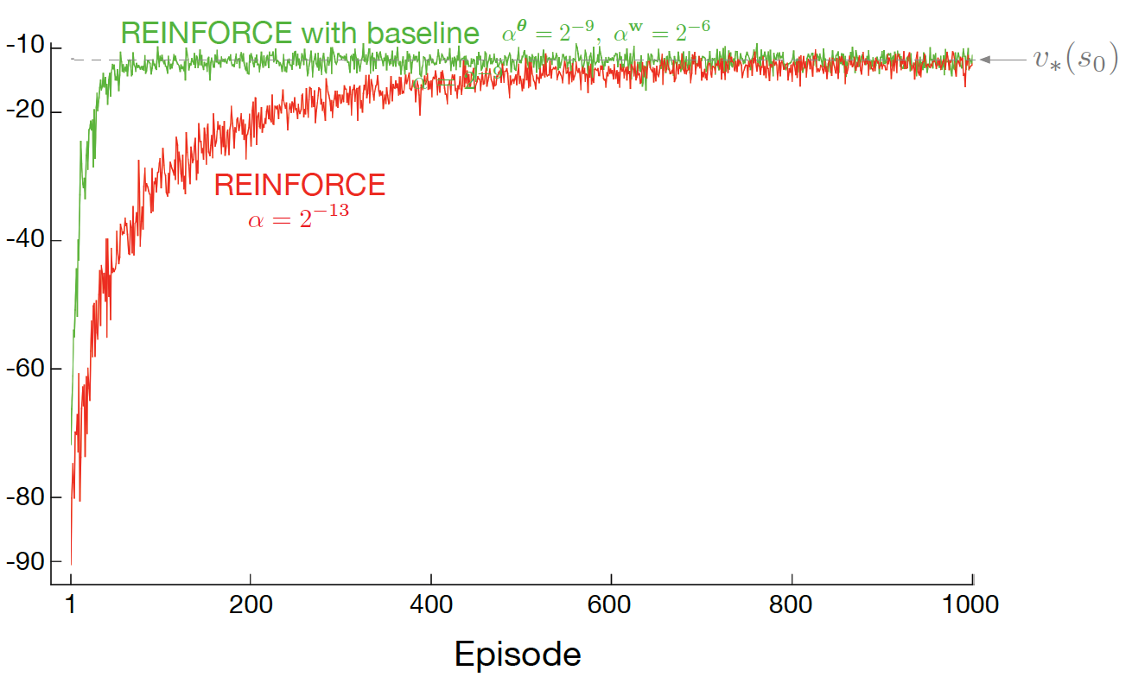
REINFORCE with advantage function

Slide 19
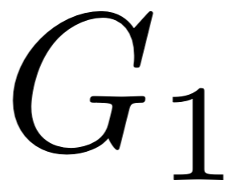
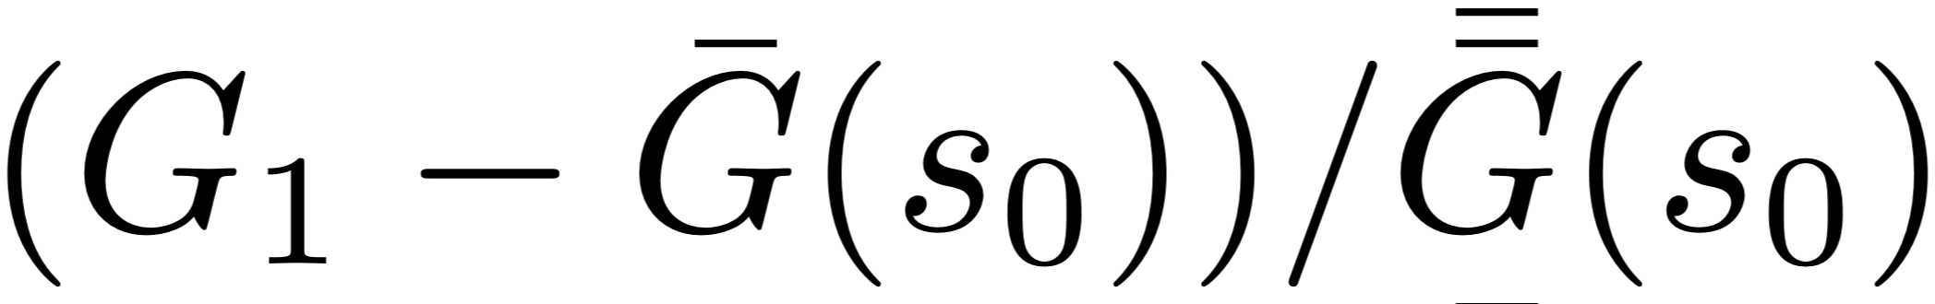
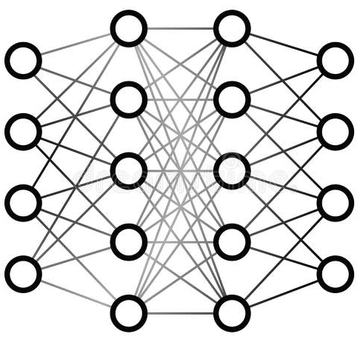
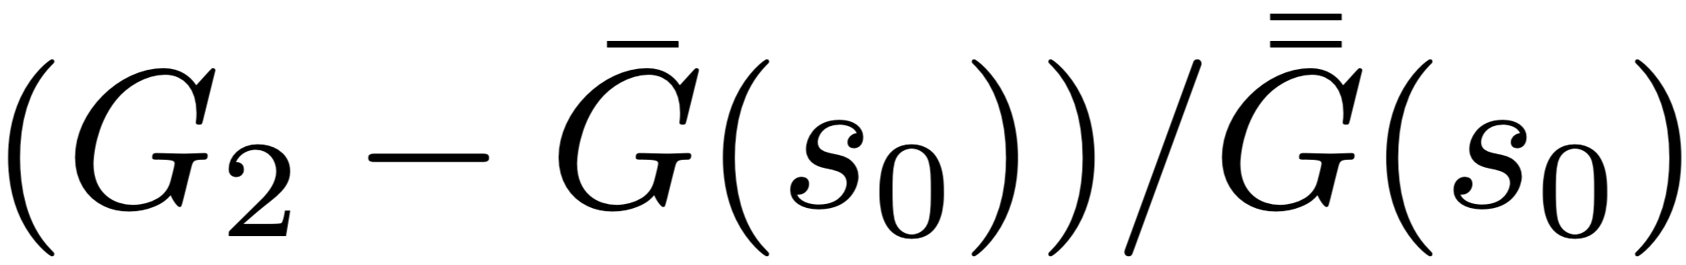
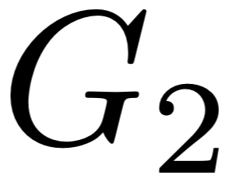
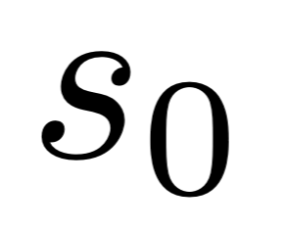
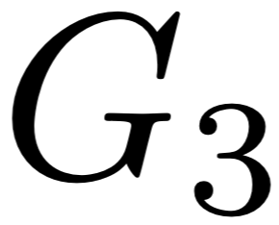
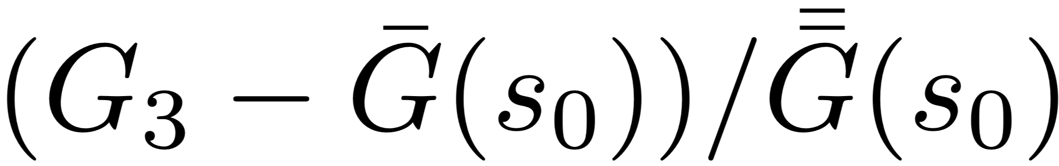
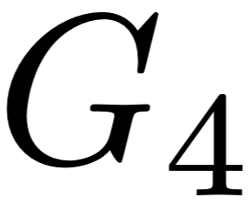
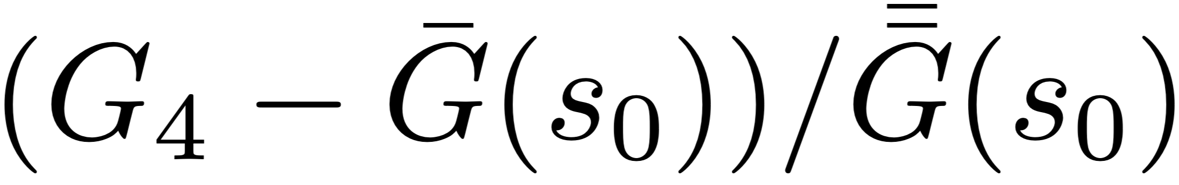
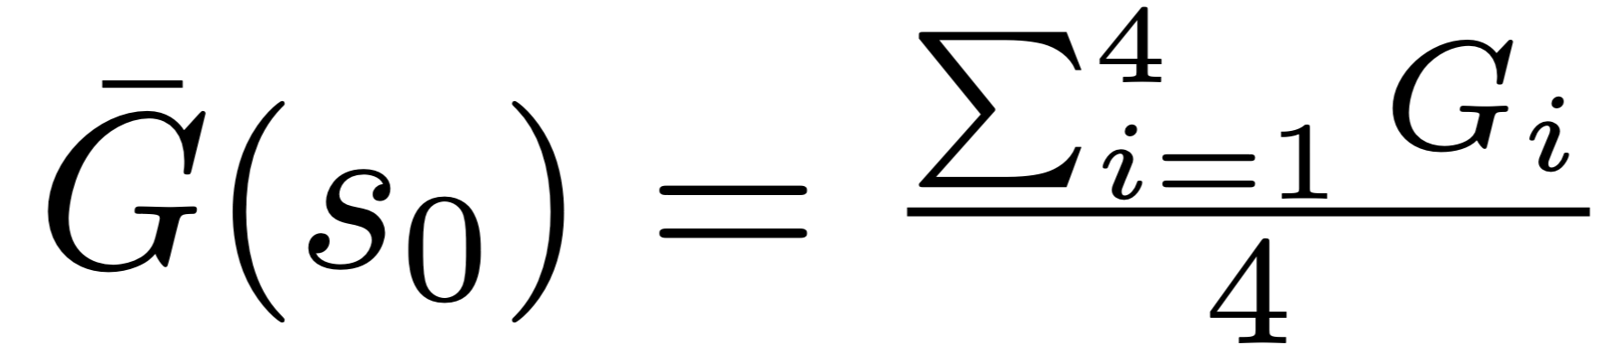
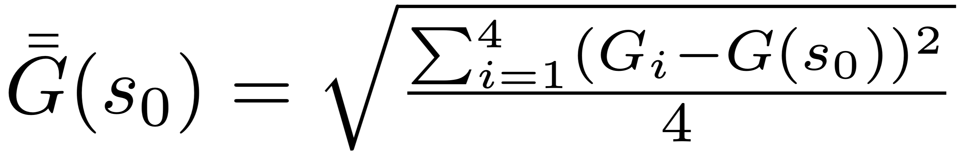
Group Relative Policy Optimization (GRPO)
Using Monto Carlo method to estimate the advantage function
Outcome signal
Advantage
Policy roll out
Solve 3x - 7 = 2x + 5
LLM/Policy
mean
standard deviation
Pros and cons? Why now?

Slide 20

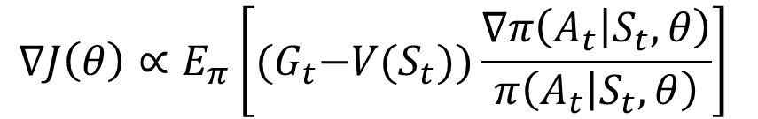
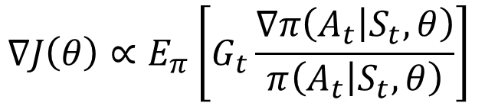
REINFORCE: Monte Carlo policy gradient
In REINFORCE, return is used to “evaluate” an action
  Vanilla version
  With advantage function
$$∇J\left(θ\right)∝E_{π}\left[G_{t}\frac{∇π\left(A_{t} | S_{t},θ\right)}{π\left(A_{t} | S_{t},θ\right)}\right]$$
$$∇J\left(θ\right)∝E_{π}\left[{(G}_{t}−V(S_{t}))\frac{∇π\left(A_{t} | S_{t},θ\right)}{π\left(A_{t} | S_{t},θ\right)}\right]$$
Do we need to wait until the episode finishes? Let’s bootstrap with TD methods!

Slide 21

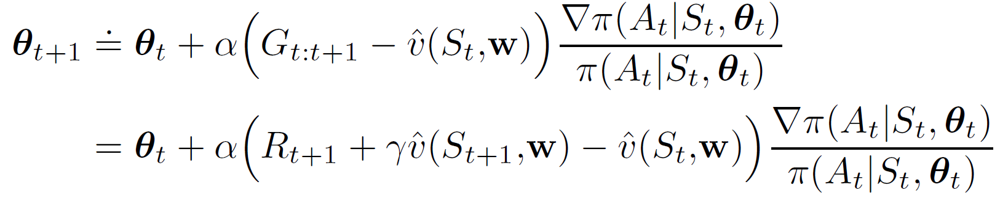


Actor-critic methods
One-step actor-critic
Let’s bootstrap this
Critic evaluates the state
Actor takes actions
Only need one step sampling from environment
Based on the current value model estimate, everything we have learnt so far applies (e.g., MC/TD)!
A source of bias due to bootstrapping!

Slide 22
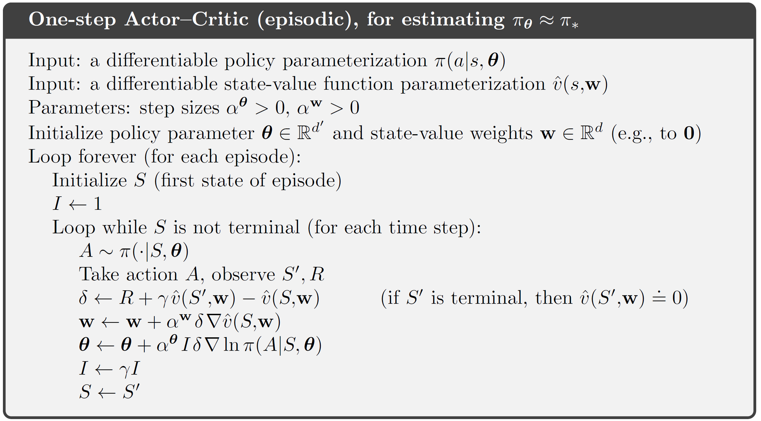
One-step actor-critic method
No need to generate an episode!
One-step return with baseline
Key to generalize to n-step methods
discount

Slide 23


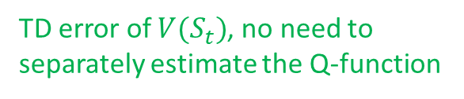
Actor-critic methods
One-step actor-critic
This can also be executed at different time scales
Action-value
State-value
Advantage function:
$$A_{π}\left(A_{t},S_{t}\right)=Q_{π}\left(A_{t},S_{t}\right)−V(S_{t})$$
TD error of $V(S_{t})$, no need to separately estimate the Q-function
TD(0)
n-step TD
Q($σ$)
TD($λ$)

Slide 24
Revisit REINFORCE
Problems in practice
What if the new policy leads to an unexplored state?
Bad value estimation there!
Stop here, if use TD methods
Problems? Serious bias!
Stop here, if use MC methods
Problems? High variance, no incremental update
Move policy not too far away from the current one: 1) Proximal Policy Optimization
2) Trust Region Policy Optimization

Slide 25
Takeaways
Directly estimate the policy, as it is eventually what we care about
  No need to follow Bellman equation, and therefore more flexible
  Higher variance and harder to optimize
Everything we have learnt for value estimation can be used here
  Actor-critic methods

Slide 26
Suggested reading
Chapter 13: Policy Gradient Methods

